Slide 1
Image Derivatives & Edge Detection

Slide 2
Sharpening Spatial Filters
Previously we have looked at smoothing filters which remove fine detail
Sharpening spatial filters seek to highlight fine detail
Remove blurring from images
Highlight edges
Sharpening filters are based on spatial differentiation

Slide 3
Sharpening filters are based on first- and second-order derivatives of image.
The derivatives of a digital function are defined in terms of differences.

Slide 4
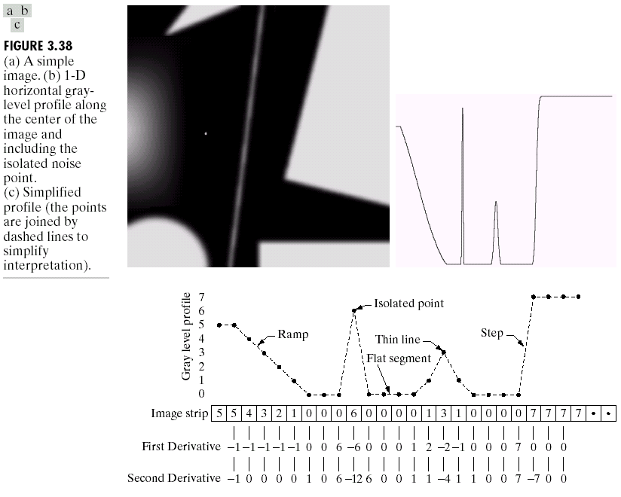
Spatial Differentiation
Let’s consider a simple 1 dimensional example

Slide 5
Spatial Differentiation
A
B

Slide 6
1st Derivative
The 1st derivative of a function is given by:
Its just the difference between subsequent values and measures the rate of change of the function

Slide 7
1st Derivative
5 | 5 | 4 | 3 | 2 | 1 | 0 | 0 | 0 | 6 | 0 | 0 | 0 | 0 | 1 | 3 | 1 | 0 | 0 | 0 | 0 | 7 | 7 | 7 | 7
 | -1 | -1 | -1 | -1 | -1 | 0 | 0 | 6 | -6 | 0 | 0 | 0 | 1 | 2 | -2 | -1 | 0 | 0 | 0 | 7 | 0 | 0 | 0

Slide 8
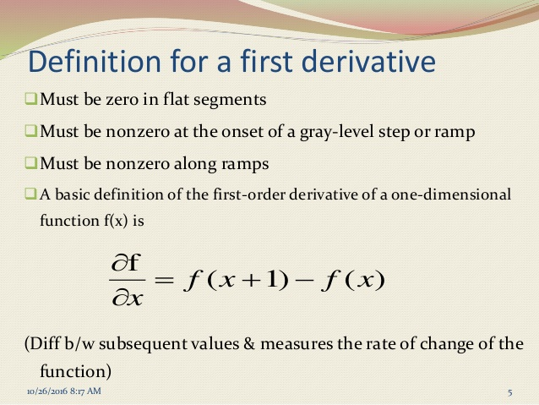

Slide 9
2nd Derivative
The 2nd derivative of a function is given by:
Simply takes into account the values both before and after the current value

Slide 10
2nd Derivative
5 | 5 | 4 | 3 | 2 | 1 | 0 | 0 | 0 | 6 | 0 | 0 | 0 | 0 | 1 | 3 | 1 | 0 | 0 | 0 | 0 | 7 | 7 | 7 | 7
 | -1 | 0 | 0 | 0 | 0 | 1 | 0 | 6 | -12 | 6 | 0 | 0 | 1 | 1 | -4 | 1 | 1 | 0 | 0 | 7 | -7 | 0 | 0

Slide 11
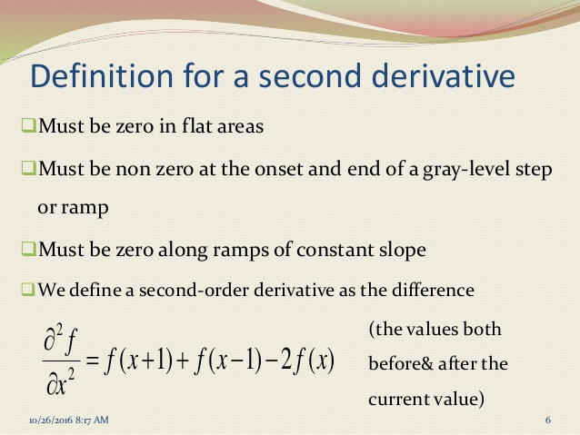

Slide 12
2nd Derivative for Image Enhancement
The 2nd derivative is more useful for image enhancement than the 1st derivative - Stronger response to fine detail
We will come back to the 1st order derivative later on
The first sharpening filter we will look at is the Laplacian

Slide 13
Laplacian Filter
The Laplacian is defined as follows:

Slide 14
Laplacian Filter
So, the Laplacian can be given as follows:
0
1
0
Can we implement it using a filter/ mask?
1
-4
1
0
1
0

Slide 15
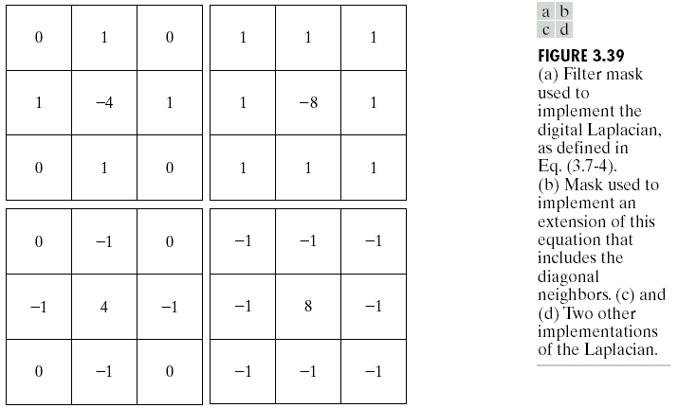
Laplacian Filter

Slide 16
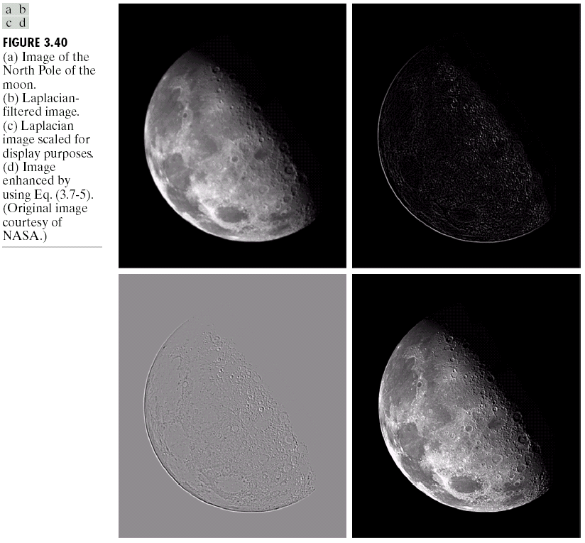
Laplacian Filter
Applying the Laplacian to an image we get a new image that highlights edges and other discontinuities
Original Image
Laplacian Filtered Image
Laplacian Filtered Image Scaled for Display

Slide 17
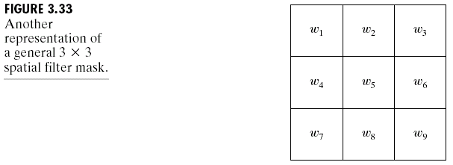
Laplacian Image Enhancement
The result of a Laplacian filtering is not an enhanced image
To generate the final enhanced image
Laplacian Filtered Image Scaled for Display

Slide 18
Laplacian Image Enhancement
-
=
Original Image
Laplacian Filtered Image
Sharpened Image
In the final sharpened image edges and fine detail are much more obvious

Slide 19
Laplacian Image Enhancement

Slide 20
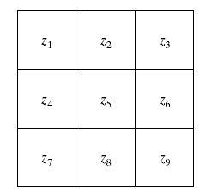
Gradient Operators
Prewitt Operator
is used for detecting edges horizontally and vertically.
Pixel Arrangement
-1 | -1 | -1
0 | 0 | 0
1 | 1 | 1
-1 | 0 | 1
-1 | 0 | 1
-1 | 0 | 1
Extract horizontal edges
Extract vertical edges

Slide 21
Gradient Operators
Sobel Operator
-1 | -2 | -1
0 | 0 | 0
1 | 2 | 1
-1 | 0 | 1
-2 | 0 | 2
-1 | 0 | 1
Extract horizontal edges
Extract vertical edges
Emphasize more the current point (x direction)
Emphasize more the current point (y direction)
Pixel Arrangement
Same as Prewitt Operator

Slide 22
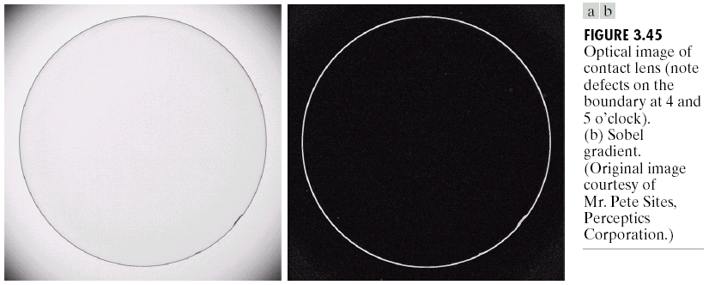
Sobel Operator: Example
Sobel filters are typically used for edge detection
An image of a contact lens which is enhanced in order to make defects more obvious

Slide 23
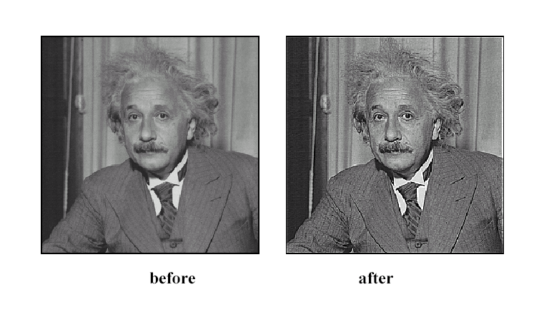
Sharpening
Source: D. Lowe

Slide 24
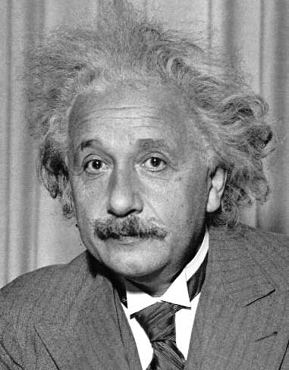
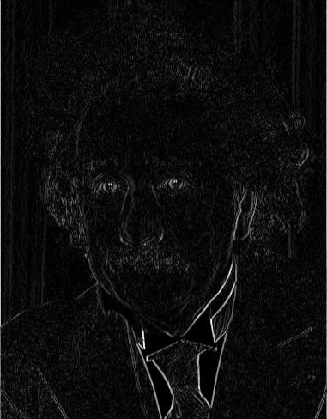
1
0
-1
2
0
-2
1
0
-1
Sobel
Vertical Edge
(absolute value)

Slide 25
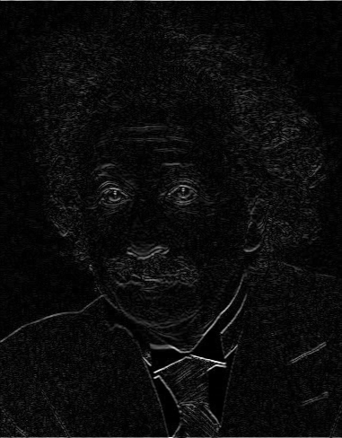
1
2
1
0
0
0
-1
-2
-1
Sobel
Horizontal Edge
(absolute value)

